Slide 1


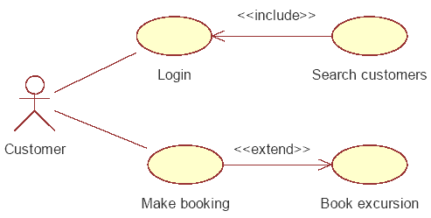
Use Case Testing
Testing the Workflows of a System
Vasil Chimev
Junior QA Engineer
Centaur Team
Telerik QA Academy

Slide 2

Table of Contents
Use Case Testing Main Concepts
Use Case Diagrams
Logical vs. Concrete Test Cases
Formal vs. Informal Use Cases
Application of Use Case Testing

Slide 3
What Is Use Case Testing
Use case testing is a way to ensure that we have tested typical and exceptional workflows and scenarios for the system
This is done from the point of view of the two sides:
Actors
Directly interacting with the system
Stakeholders
Indirectly interacting with the system

Slide 4
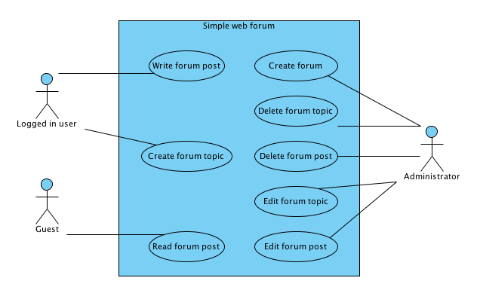
Use Case Testing
Use case testing definition:
A black-box test design technique in which test cases are designed to execute user scenarios

Slide 5
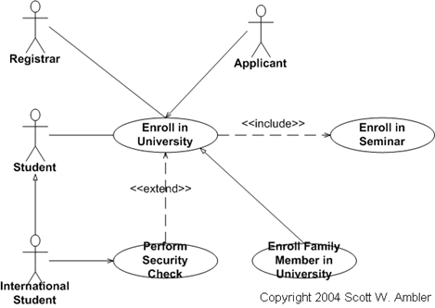
Use Case
Use case definition:
A sequence of transactions in a dialogue between a user and the system with a tangible result

Slide 6

When Use Case Testing Is Not Appropriate?
In some cases state-based testing may be more appropriate
If we have heavy interaction of past events and conditions with the way current events and conditions should be handled

Slide 7
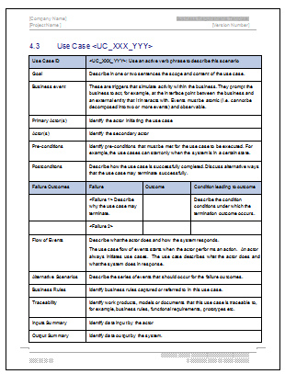
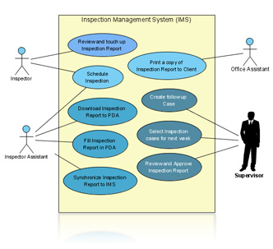
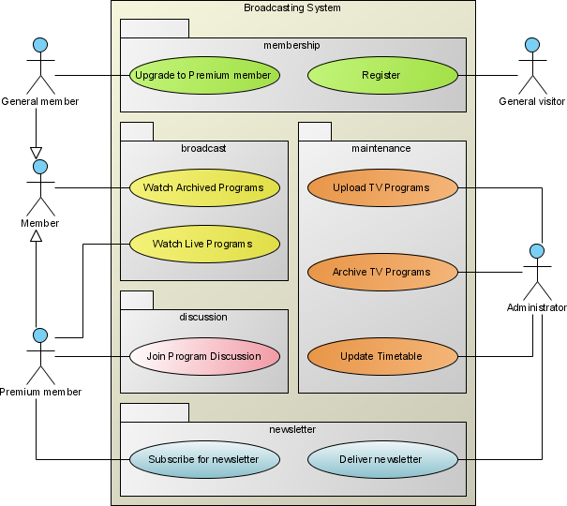
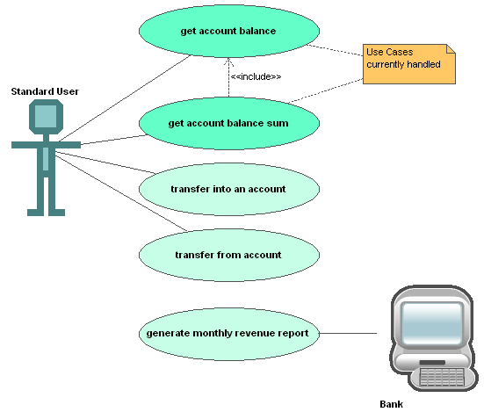
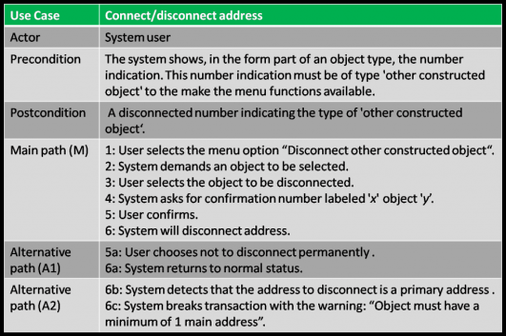
Use Case Informality
The concept of a "use case" can vary considerably in formality and presentation

Slide 8
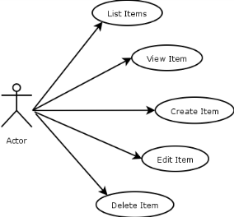
Use Case Informality (2)
The basic idea of use cases is simple:
We have some numbered (or at least sequential) list of steps
Describes how an actor interacts with the system
The steps can be shown in text or as part of a flowchart
Use cases also show the results obtained at the end of the sequence of steps

Slide 9
Normal Workflow vs. Exceptions
Use Cases represent two basic scenarios:
Normal workflow
Shows the typical, normal processing
Also called: the primary scenario, the normal course, the basic course, the main course, the happy path, etc.
Exceptions
Shows abnormal processing
Also called: exceptions, exceptional processing, or alternative courses

Slide 10

Receiving Use Cases
In most cases test analysts do not create use cases – they receive them
Test analysts create their tests based on use cases

Slide 11
Deriving Test Cases
A test should be created for every workflow
Including both: typical and exceptional workflows
Sometimes exceptional workflows are not provided with the use cases received
Test analysts have to prepare them using requirements or some other sources
Failing to test exceptions is a common testing mistake when using informal use cases

Slide 12
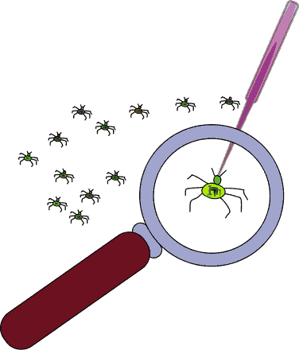
The Bug Hypothesis
Use case testing is looking for possible bugs in situations where:
The system interacts improperly with the user
The system delivers an improper result

Slide 13

Combining Use Cases And Other Test Techniques
Use Cases Testing can involve applying other test techniques:
Equivalence partitioning
Boundary value analysis
Decision table
When combinations of conditions determine the actions

Slide 14
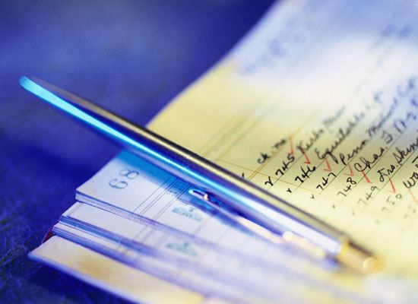
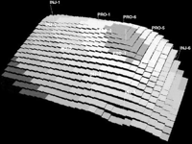
Deriving Tests With Use Cases
Examples

Slide 15
E-commerce Site Use Case Example
An example of a use case describing purchases from an e-commerce site may look like:
E-commerce purchase: Normal workflow
Customer places one or more Items in shopping cart
Customer selects checkout
System gathers address, payment, and shipping information from Customer
System displays all information for User confirmation
User confirms order to System for delivery

Slide 16
E-commerce Site Use Case Example (2)
An example of a use case describing purchases from an e-commerce site may look like:
Exceptions
Customer attempts to check out with an empty shopping cart; System gives an error message
Customer provides invalid address, payment, or shipping information; System gives error messages as appropriate
Customer abandons transaction before or during checkout; System logs Customer out after 10 minutes of inactivity

Slide 17
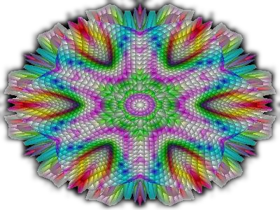
Deriving The Test Cases
Deriving test cases includes mapping each step of the workflow into a step in the test procedure
Variations of a test procedure
A few variations of a test case having the same core steps can be described on a single row, appended to the base test case

Slide 18
Deriving The Test Cases (2)
A test case for the normal workflow can be:
# | Test Step | Expected Result
1 | Place 1 item in cart | Item in cart
2 | Click checkout | Checkout screen
3 | Input valid address, valid payment using American Express, and valid shipping method information | Each screen displays correctly and valid inputs are accepted
4 | Verify order information | Show as entered
5 | Confirm order | Order in system
6 | Repeat steps 1-5, but place 2 items in cart, and pay with Visa, and ship international | As shown in 1-5
7 | Repeat steps 1-5, but place the maximum number of items in cart and pay with MasterCard | As shown in 1-5
8 | Repeat steps 1-5, but pay with Discover | As shown in 1-5

Slide 19
Deriving The Test Cases (3)
An exceptional test case can be:
# | Test Step | Expected Result
1 | Do not place any items in cart | Cart empty
2 | Click Checkout | Error message
3 | Place item in cart, click checkout, enter invalid address, then invalid payment, then invalid shipping information | Error messages, can't proceed to next screen until resolved
4 | Verify order information | Shown as entered
5 | Confirm order | Order in system
6 | Repeat steps 1-3, but stop activity and abandon transaction after placing item in cart | User logged out exactly 10 minutes after activity
7 | Repeat steps 1-3, but stop activity and abandon transaction on each screen | As shown in 6
8 | Repeat steps 1-4, do not confirm order | As shown in 6

Slide 20
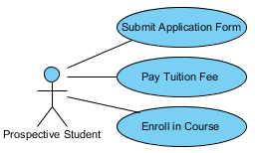
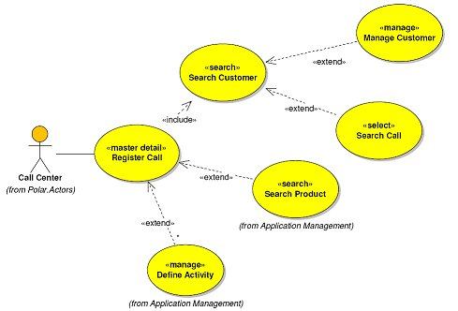
Use Case Diagrams
Graphical Representation of Use cases

Slide 21
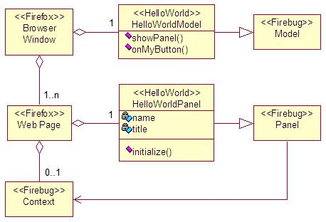
UML
Use cases can be graphically presented as diagrams using UML
Serve the purpose of defining requirements on a relatively abstract level
Describe typical user-system interactions

Slide 22
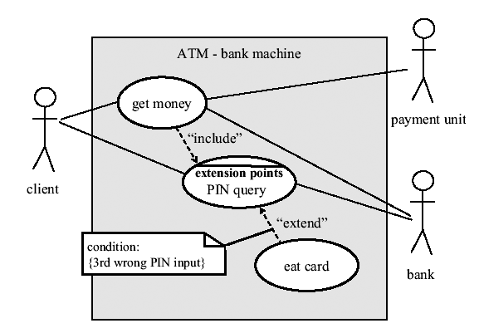
Use Case Diagram - Example
This is an example of use case diagram for an ATM machine:

Slide 23

Include vs. Extend Conditions
In use case diagrams relationships between use cases can be:
"Include" conditions
Always executed
"Extend" conditions
Can lead to extensions of a use case under certain conditions at a certain point (extension point)
Not always executed as there are alternatives

Slide 24
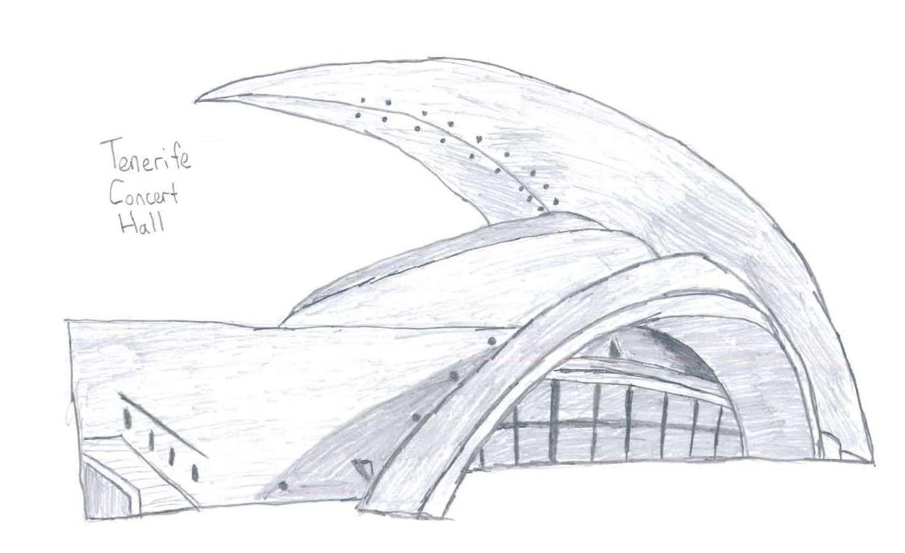
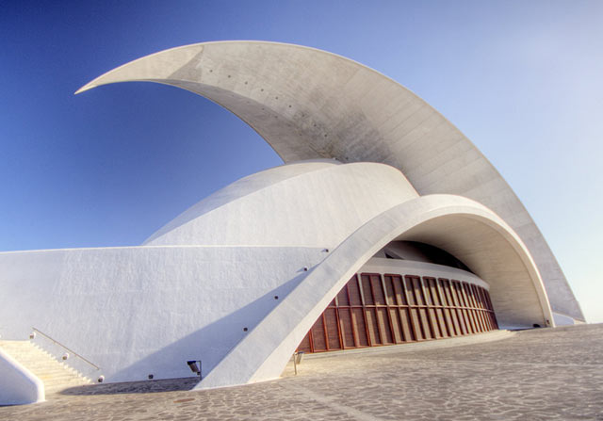
Logical vs. Concrete Test Cases

Slide 25
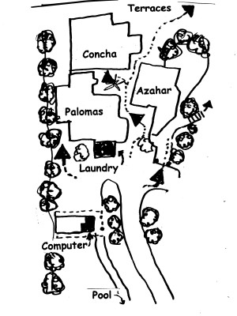

Logical vs. Concrete Test Cases
According to the level of detail test cases are considered to be two main types:
Logical (or high-level) test cases
Concrete (or low-level) test case

Slide 26
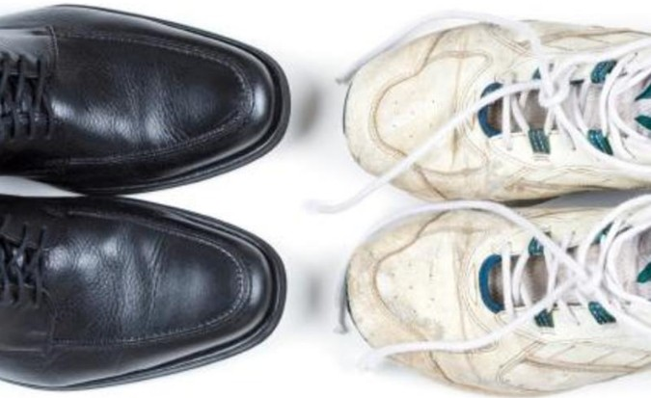
Formal vs. Informal Use Cases

Slide 27

Formal vs. Informal Use Cases
Use cases shown in previous slides are also called informal
Contain only the main steps of a user-system interaction
Another type of use cases are formal use cases
Contain more information than informal use cases

Slide 28
Elements of a Formal Use Case
The typical elements of a formal use case are:
ID
Some use case identifier number
Name
A short name, like E-commerce Purchase
Actor
The actor, such as Customer
Description
A short description of the use case

Slide 29
Elements of a Formal Use Case (2)
The typical elements of a formal use cases are:
Priority
The priority, from an implementation point of view
Frequency of use
How often this will occur
Preconditions
What must be true to start the use case normally

Slide 30
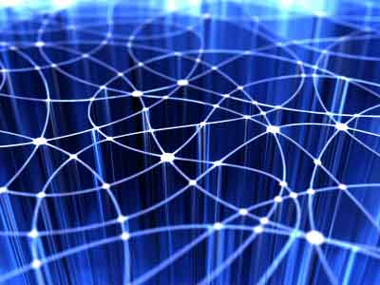
Elements of a Formal Use Case (3)
The typical elements of a formal use cases are:
Typical workflow - often like the informal use case, but sometimes broken into two columns:
One for the actor actions
One for the system response

Slide 31
Elements of a Formal Use Case (4)
The typical elements of a formal use cases are:
Exception workflows
One for each exception
Often also includes actor action and system response columns
Postconditions
Specifies what should be true about the state of the system after the use case completes normally

Slide 32
Formal Use Case Example
The header of a formal use case can be:
ID | 02.001
Name | E-commerce Purchase
Actor | Customer
Description | Allow customer to compile a transaction by purchasing the item(s) in her shopping cart
Priority | Very high
Frequency of use | 25% of customers, up to 1,000 customers per day
Preconditions | 1. One or more items in shopping cart 2. Customer is logged in 3. Customer has clicked on checkout
Some of the informal use case steps become preconditions

Slide 33
Formal Use Case Example (2)
The main body of a formal use case can be:
Typical workflow | 1. System gathers address, payment and shipping information from Customer 2. System displays all information for User confirmation 3. User confirms order to System for delivery
Exception 1 | Customer attempts to checkout with empty shopping cart System gives error message
Exception 2 | Customer provides invalid address, payment or shipping information System gives error messages as appropriate
Exception 3 | Customer abandons transaction before or during checkout System logs out Customer out after 10 minutes of inactivity
Postconditions | Order is active in system
True only if the normal workflow is completed

Slide 34


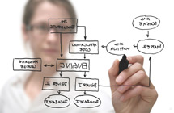

Application of Use Case Testing

Slide 35

Application of Use Case Testing
The use case testing technique is useful for both system testing and acceptance testing
Testing typical user system interactions
Application in integration testing
When use case diagrams are used to model the interactions between different subsystems

Slide 36
Use Case Testing
?
?
?
?
?
Questions?
?
?
?
?
?
?

Slide 37
Exercises (1)
Which of the following types of defects is use case testing MOST LIKELY to uncover?
Defects in the process flows during real-world use of the system
Defects in the interface parameters in integration testing
Integration defects caused by the interaction and interference of different components
Defects in the system as it transitions between one state and another

Slide 38
Exercises (2)
Use cases can be performed to test:
Performance testing
Unit testing
Business scenarios
Static testing
Test Conditions are derived from:
Specifications
Test Cases
Test Data
Test Design

Slide 39
Exercises (3)
The Test Cases derived from use cases:
Are most useful in uncovering defects in the process flows during real world use of the system
Are most useful in uncovering defects in the process flows during the testing use of the system
Are most useful in covering the defects in the process flows during real world use of the system
Are most useful in covering the defects at the Integration Level

Slide 40
Exercises (4)
In the next few slides a semiformal use case of a bank system for home equity loans is provided
Derive logical test cases for testing the normal and the exceptional workflows for the system
Create use case diagram based on this use case

Slide 41
Exercises (5)
Actor | Telephone Banker
Preconditions | The Telephone Banker is logged into Loan System.
Normal Workflow | The Telephone Banker receives a phone call from a Customer. The Telephone Banker interviews the Customer, entering information into the Loan System through a Web browser interface on their Desktop. Once the Telephone Banker has gathered the information from the Customer, the Loan System determines the creditworthiness of the Customer using a Scoring Mainframe. Based on all of the Customer information, the Loan System displays various Home Equity Products that the Telephone Banker can offer to the customer. If the Customer chooses one of these Products, the Telephone Banker will conditionally confirm the Product. The interview ends. The Telephone Banker directs the Loan System to transmit the loan information to the Loan Document Printing System (LoDoPS) in the Datacenter for origination.

Slide 42
Exercises (6)
Actor | Telephone Banker
Exception Workflow 1 | During step 2 of the normal workflow, if the Customer is requesting a large loan or borrowing against a high-value property, the Telephone Banker escalates the application to a Senior Telephone Banker who decides whether to proceed with the application. If the decision is to proceed, then the Telephone Banker completes the remainder of step 2 and proceeds normally. If the decision is not to proceed, the Telephone Banker informs the Customer that the application is declined and the interview ends.
Exception Workflow 2 | During step 4 of the normal workflow, if the System does not display any Home Equity Products as available, the Telephone Banker informs the Customer that the application is declined and the interview ends.

Slide 43
Exercises (7)
Actor | Telephone Banker
Exception Workflow 3 | During step 5 of the normal workflow, if the Product chosen by the Customer was a Home Equity Loan, the Telephone Banker offers the Customer the option of applying for life insurance to cover the loan. If the Customer wants to apply, the following steps occur: The Telephone Banker interviews the Customer, entering health information into the Loan System through a Web browser interface on their Desktop. The Loan System processes the information. One of two outcomes will occur: a. The Loan System declines to offer insurance based on the health information given. The Telephone Banker informs the Customer that the insurance application was denied. This exception workflow is over and processing returns to step 5. b. The Loan System offers insurance at a rate based on the loan size and the health information given. The Telephone Banker informs the Customer of the offer.

Slide 44
Exercises (8)
Actor | Telephone Banker
 | The Customer makes one of two decisions: a. Accept the offer. The Telephone Banker makes the life insurance purchase part of the overall application. This exception workflow is over and processing returns to step 5. b. Reject the offer. The Telephone Banker excludes the life insurance purchase from the overall application. This exception workflow is over and processing returns to step 5.
Exception Workflow 4 | During any of steps 1 through 5 of the normal workflow, if the Customer chooses to end the interview without continuing the process or selecting a product, the application is cancelled and the interview ends.
Exception Workflow 5 | If no Telephone Banker is logged into the system (e.g., because the system is down) and step 1 of the normal workflow begins, the following steps occur:

Slide 45
Exercises (9)
Actor | Telephone Banker
 | The Telephone Banker continues to take the information manually. At the end of the interview, the Telephone Banker informs the Customer that a Telephone Banker will call back shortly with the decision on the application. Once a Telephone Banker is logged into the system, the application information is entered into Loan System and normal processing resumes at step 2. The Telephone Banker calls the Customer once one of the following outcomes has occurred: Step 5 of normal processing is reached. Processing continues at step 5. At step 2 of normal processing, exception workflow 1 was triggered. Processing continues at step 2. At step 4 of normal processing, exception workflow 2 was triggered. No processing remains to be done.
Postconditions | Loan application is in LoDoPS system for origination.

Slide 46
Exercises (10)
In the next few slides a semiformal use case of an elevator is provided
Derive exceptional workflows for the use case
Derive concrete test cases for testing the normal and the exceptional workflows for the system
Create use case diagram based on this use case

Slide 47
Exercises (11)
Use Case Name | Use Elevator
Summary: | Rider calls an elevator and uses it to ride to another floor
Actor | Elevator rider
Preconditions | Elevator is in service
Normal Workflow | Rider presses elevator call button Elevator system detects elevator call button pressed Elevator moves to the floor Elevator doors open Rider gets in and presses floor button Elevator doors closes If requested floor is in the same direction the elevator is going, elevator moves to requested floor If requested floor is not in the same direction the elevator is going, and no floors have been requested in that direction, elevator changes direction and moves to required floor

Slide 48
Exercises (12)
Use Case Name | Use Elevator
Normal Workflow | If requested floor is not in the same direction the elevator is going, and at least one floor has been requested in that direction, elevator continues processing requests in the same direction until all requests are satisfied, then changes direction and moves to required floor Elevator doors open Rider gets out Elevator doors closes If the elevator has no more requests, it moves to its home floor

Slide 49
Exercises (13)
For the following demo: http://demos.telerik.com/silverlight/#DataForm/ICollectionViewSynchronization you have Edit item use case:
Formal Use Case
ID: | DF0001
Name: | Edit item
Description: | Customer navigates the DataForm demo and edits an item
Actor goal: | To enter its own data
Actor: | Customer
Priority: | Very high
Basic flow: | 1. Navigate http://demos.telerik.com/silverlight 2. Find DataForm --> ICollectionViewSynchronization demo 3. Choose an item 4. Edit the item 5. Save changes
Post-conditions: | The data are entered and saved correctly

Slide 50
Exercises (14)
Define alternate and exceptional flows
Think about which steps could be Pre-conditions
Derive test cases using one of the templates below:
Test case template:
Action: | Actor
Verification: | System
Action: | Actor
Verification: | System
… | ….
Test case template:
Use case steps: | Test case steps: | Expected result:
… | … | …

